Slide 1
The Colchester Library Association and it’s Successor the Cragin Memorial Library
Gary A. Walter
Colchester Historical Society
March 2021

Slide 2
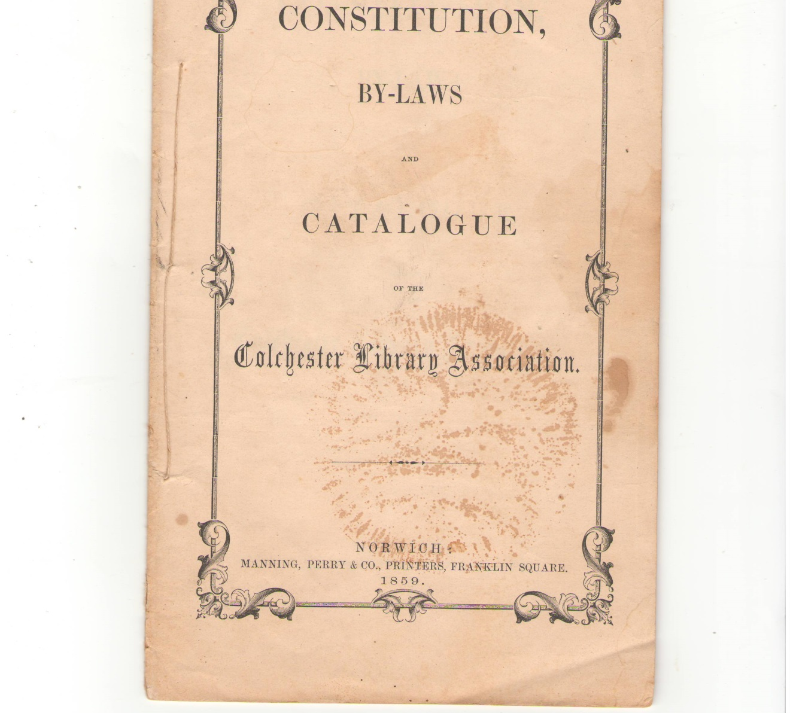
Cover of 1859 Colchester Library Association (CLA) Brochure
The CLA was formed in January of 1859 with the merger of the men only Library Association of Colchester and the Ladies Library Association, both of which started in 1856 as Lyceums or debating societies. The first president of the CLA was E. Carpenter and the first librarian was C. H. Rogers.

Slide 3
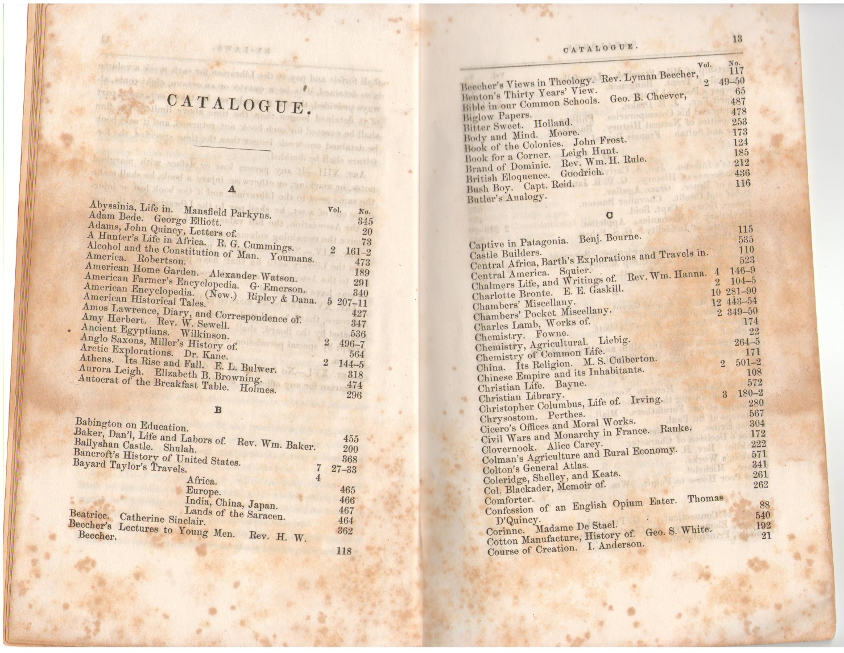
The Beginning of the Catalogue Portion of the CLA’s 1859 Brochure
Shown above are the first two pages of the catalogue section of the CLA’s 1859 brochure. The catalogue listing takes up 10 pages of the brochure. The brochure also has pages with the collection broken up into the following classifications: Biography, Essays and Lectures, History, Politics, Narratives, Periodicals, Poetry, Science and Art, Congressional Documents, Religion, Miscellaneous and Juvenile.

Slide 4
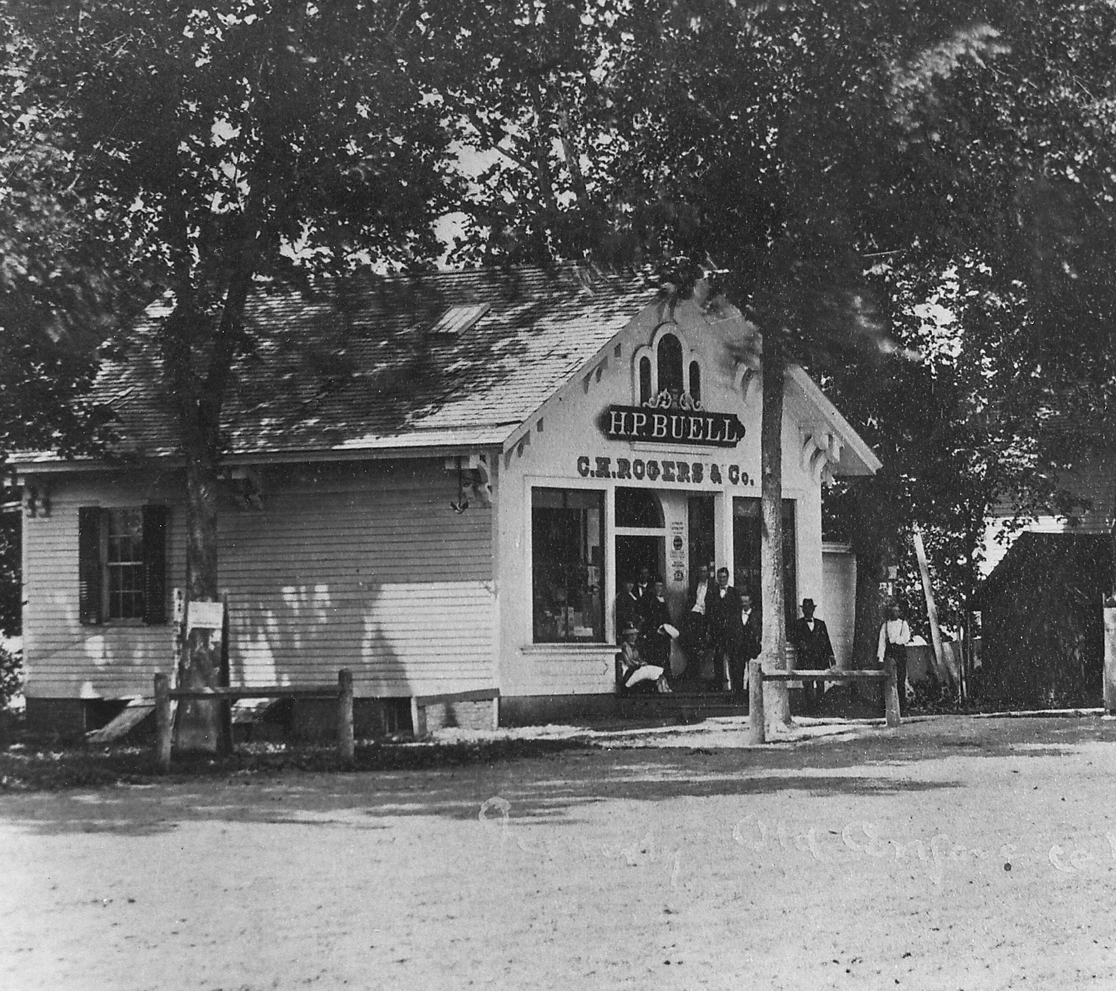
Library first kept in C. H. Rogers Store on South Main Street
In addition to what the early groups had collected In March of 1859 the CLA authorized the purchase of $280 worth of books and other content for the Library. Charles H. Rogers as the CLA Librarian offered his store on South Main Street, next to the Firehouse, as a depository for the organization’s holdings.

Slide 5
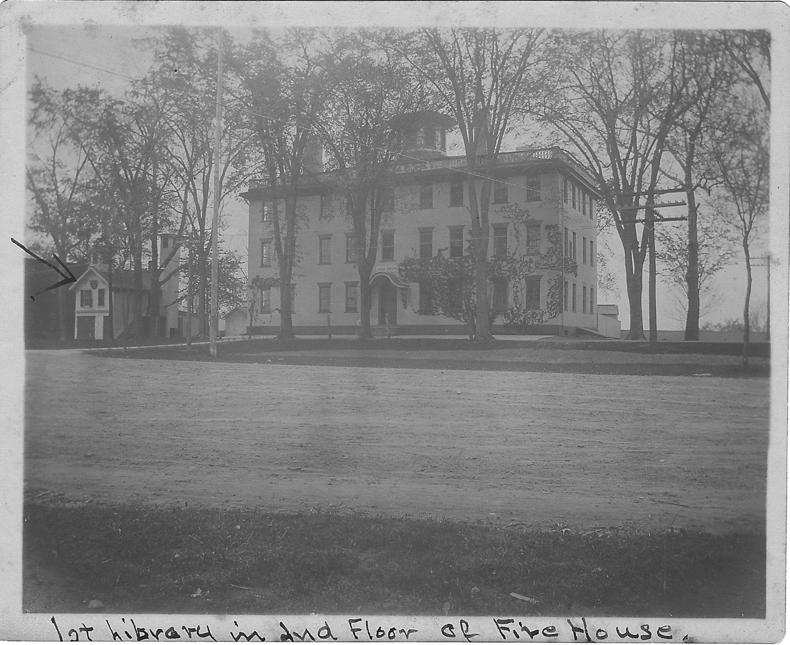
The Second Floor of the Firehouse was the Library’s next Home
Sometime in early 1861 the CLA moved to the second floor of the Firehouse, next door to Roger’s store, where it was not only able to house the CLA’s collections, but to also establish its first public Reading Room. The CLA Library occupied this space for over 20 years without being charged any rent as a public service to the town.

Slide 6
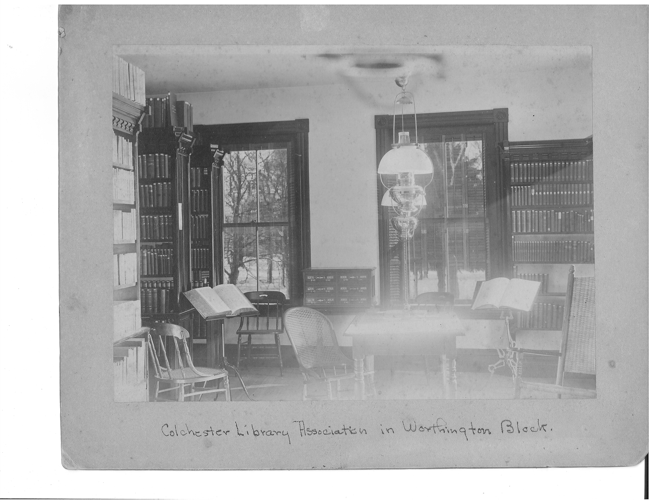
CLA Reading Room in the Worthington Block on Merchants’ Row
In 1879 the Connecticut General Assembly granted the CLA a Charter of Incorporation thus making it a legal entity. In 1884 the CLA started moving its collections and operation to the second floor of the Worthington Block on Merchants’ Row, which was finally opened to the public in April of 1866. As can be seen in this and the next slide the collections of the CLA by the late 1880’s were quite large.

Slide 7
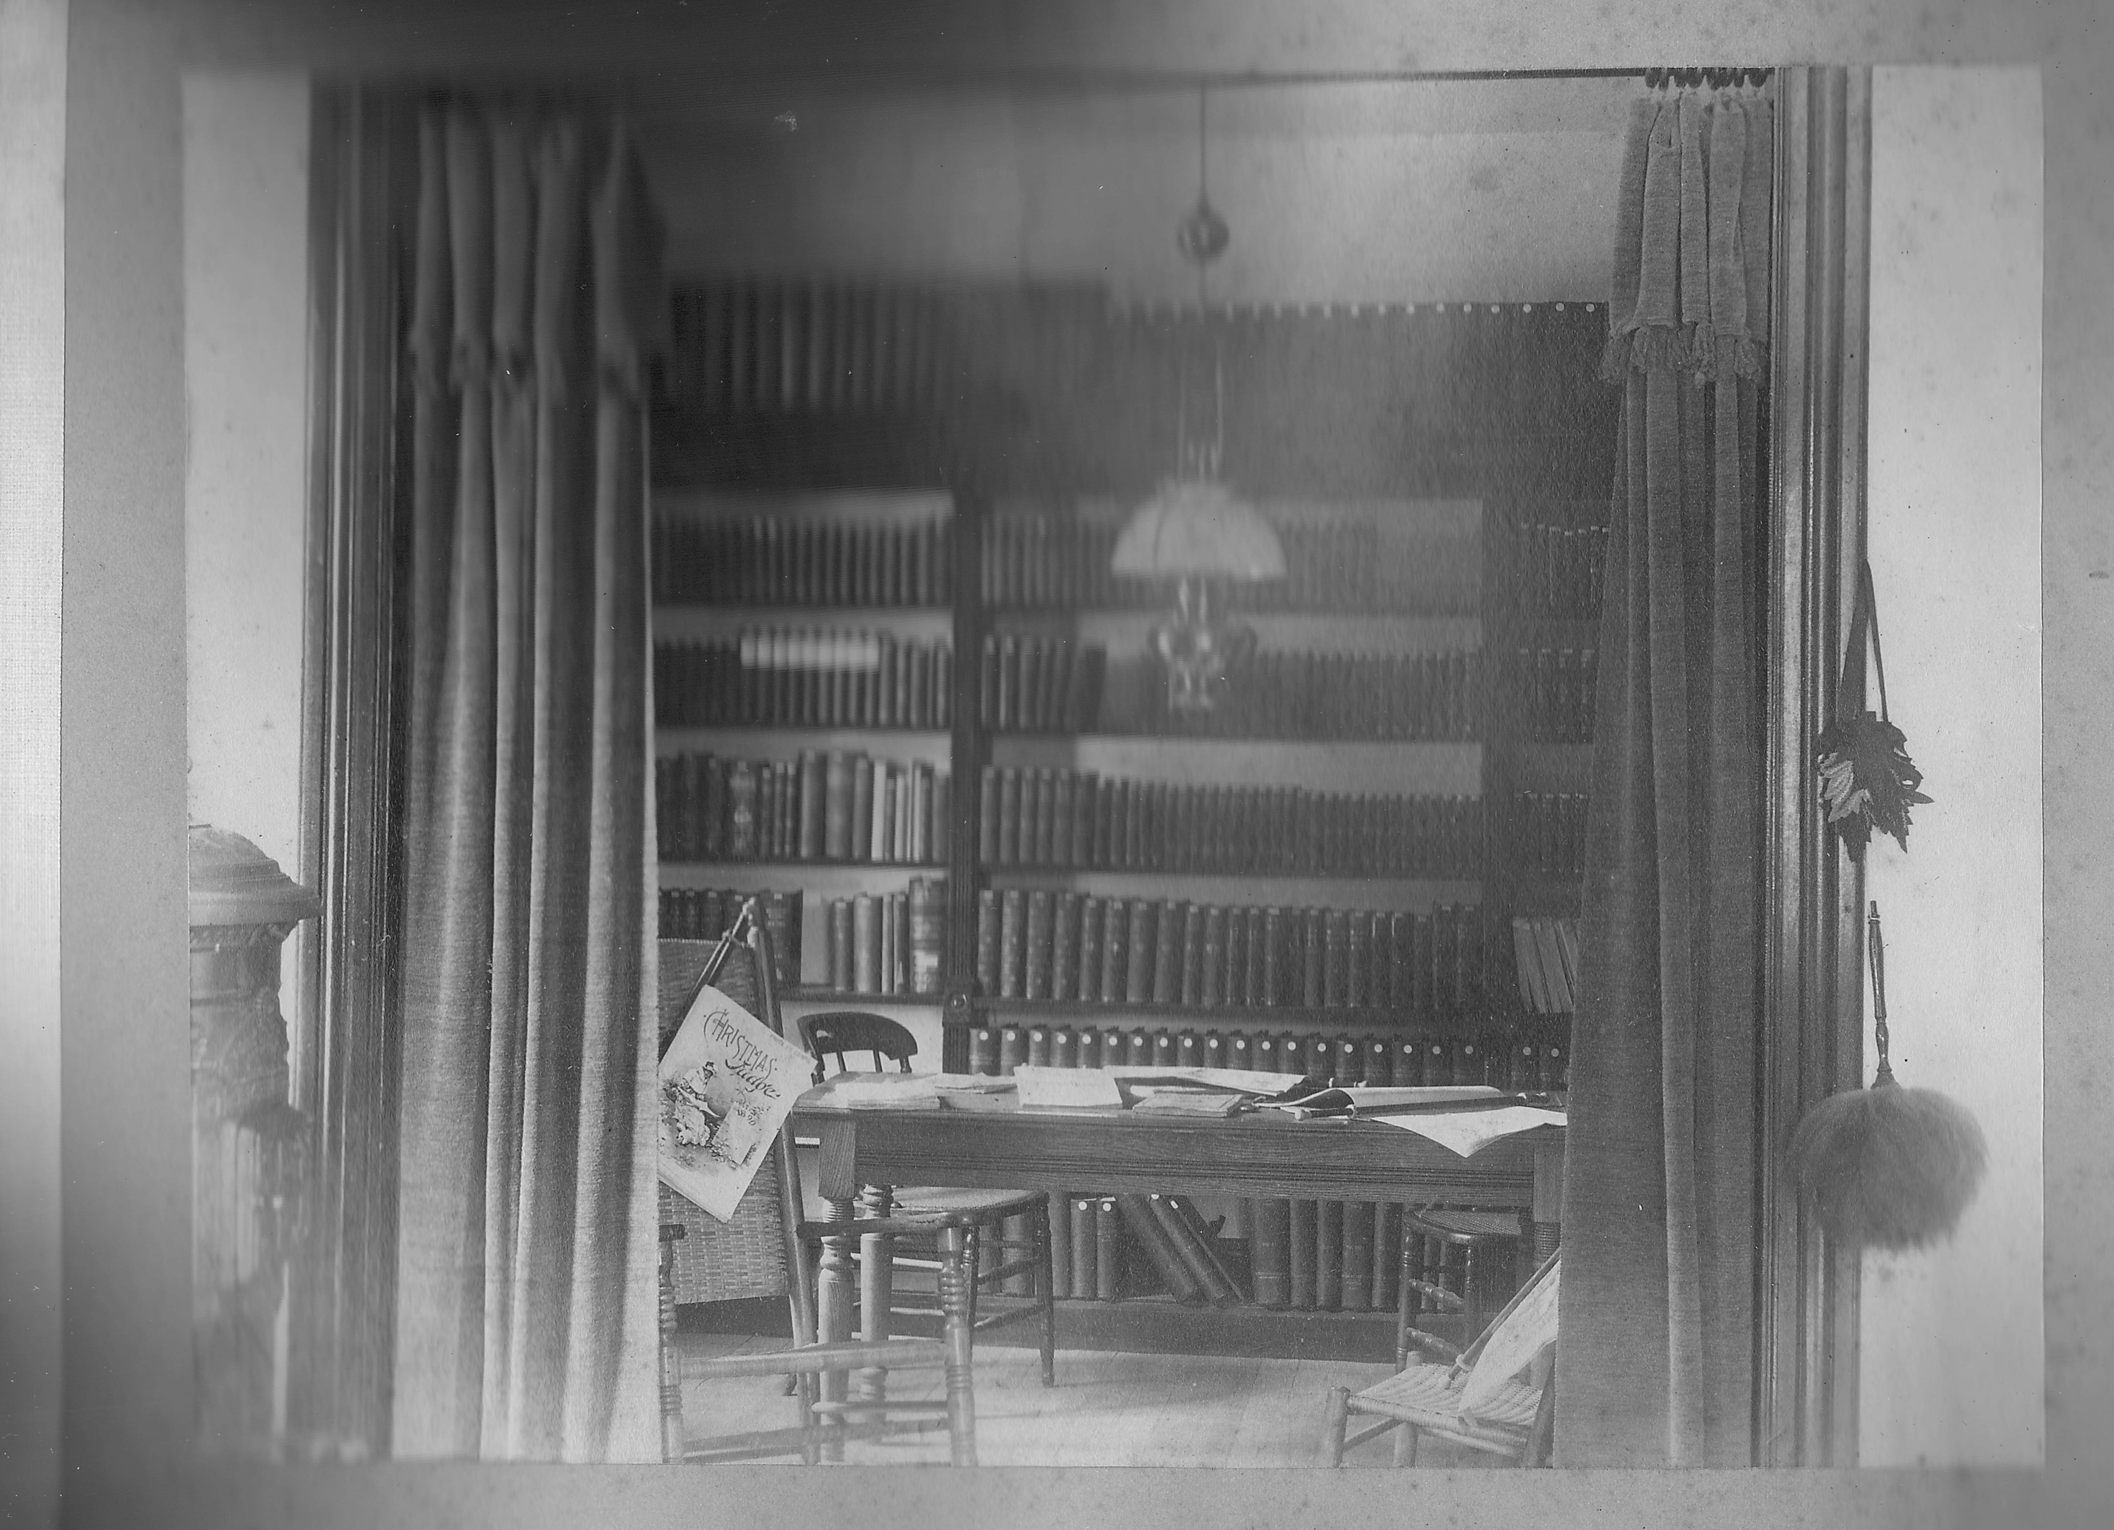
The CLA Annex in the Worthington Block on Merchants’ Row
The above photograph shows the CLA Annex room on the second floor of the Worthington Block on Merchants’ Row. Unfortunately the Merchants’ Row fire of June 1890 completely destroyed the CLA’s entire collection, except for what was out in circulation. Fortunately the association had insurance and investments such that once the Worthington Block was rebuilt the CLA was able to move back in and by 1893 had built its new collection back to more than 2,000 bound volumes.

Slide 8
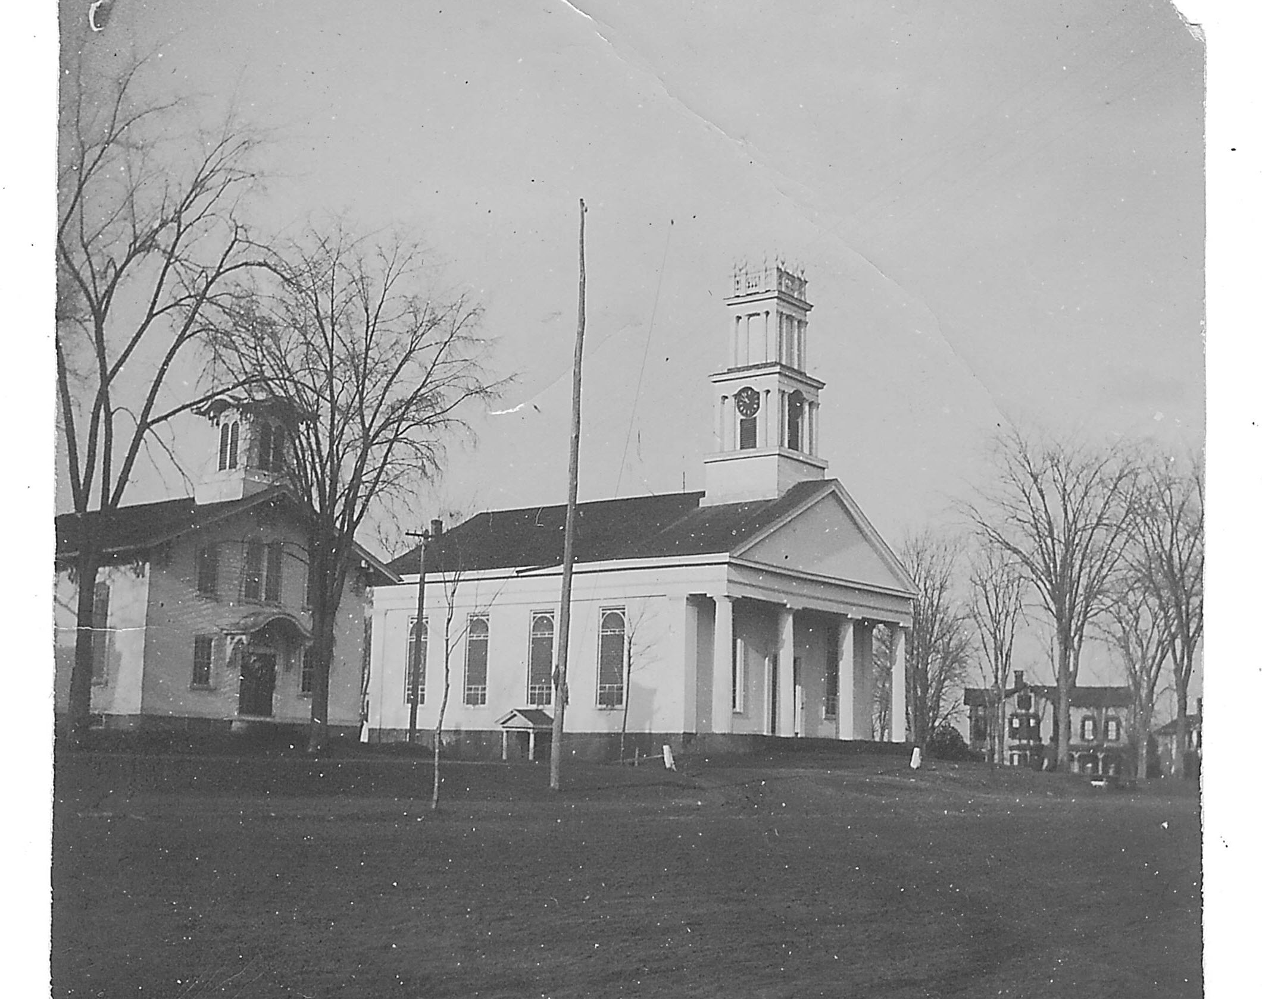
Cragin House on Linwood Avenue in Background, c 1890
The above photograph with the Cragin House on Linwood Avenue visible in the background is the best image of the house known to exist. This was the house that Edwin B. Cragin grew up in. By 1898 Cragin was a successful doctor in New York City and the house was occupied by his widowed mother, Ardelia. In May of that year the last of the big Merchants’ Row fire also destroyed this house. Mrs. Cragin then moved to a house on Hayward Avenue and the Linwood site was cleared and left empty.

Slide 9
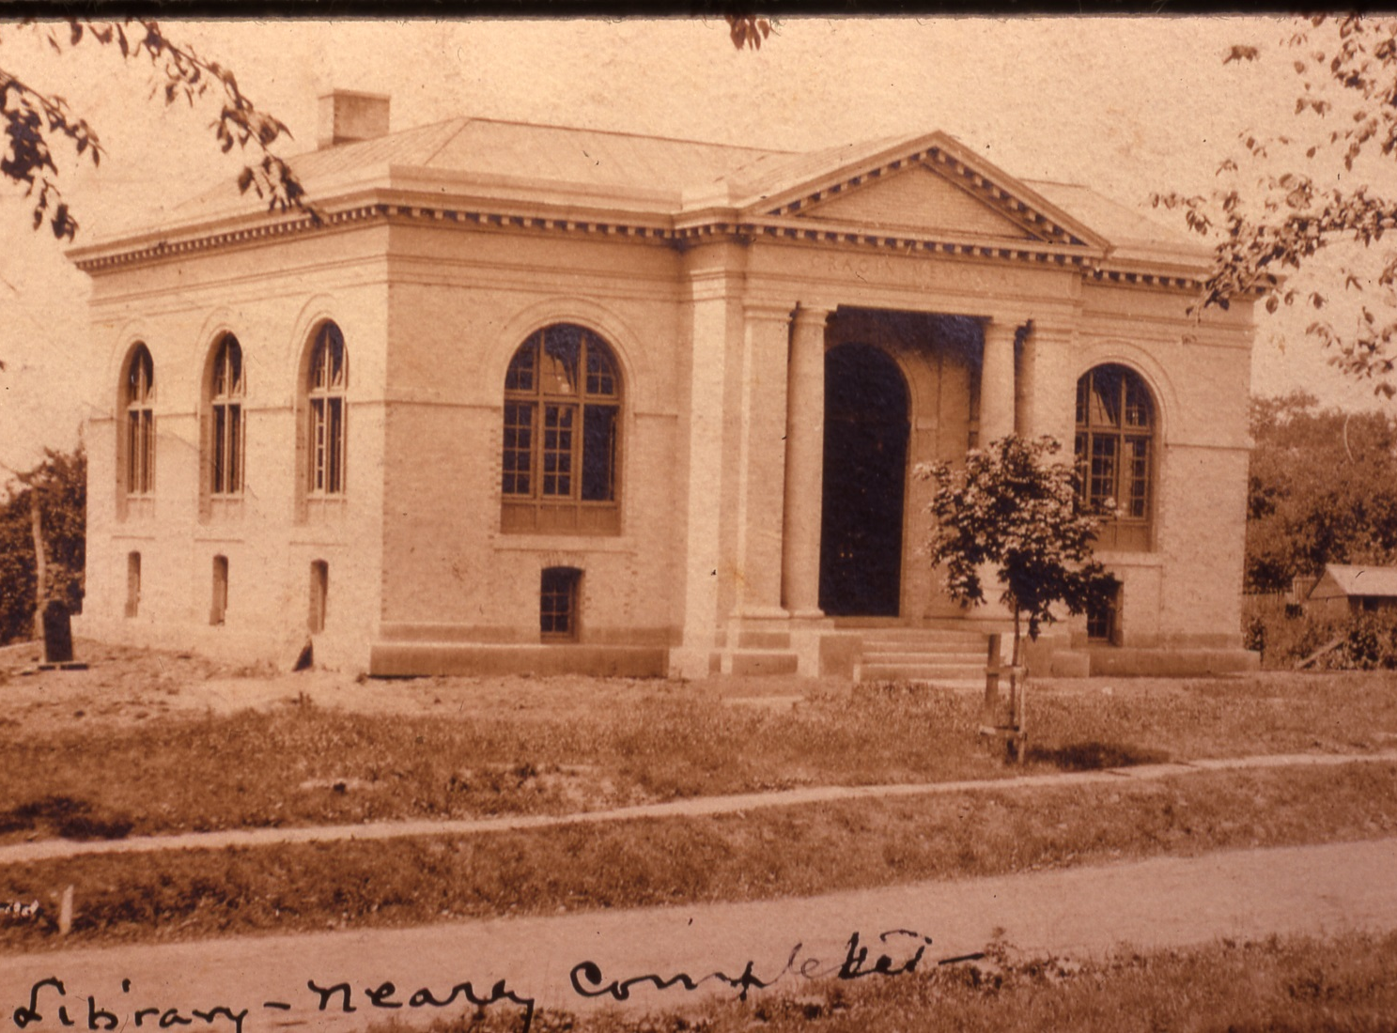
Cragin Memorial Library on Linwood Avenue in 1905
In 1903 Dr. Edwin B. Cragin announced that he was donating the Linwood Avenue site and $30,000 for the building, furnishing and stocking of a public library for the town of Colchester. The library was dedicated on July 5, 1905 and was named the Cragin Memorial Library in honor of Dr. Cragin’s late father Edwin T. Cragin. The CLA donated its collection of about 3,000 books to the 5,000 that Cragin Memorial library had purchased by the time it opened and the CLA continued to raise money for and advise the library until they disbanded in 1923.

Slide 10
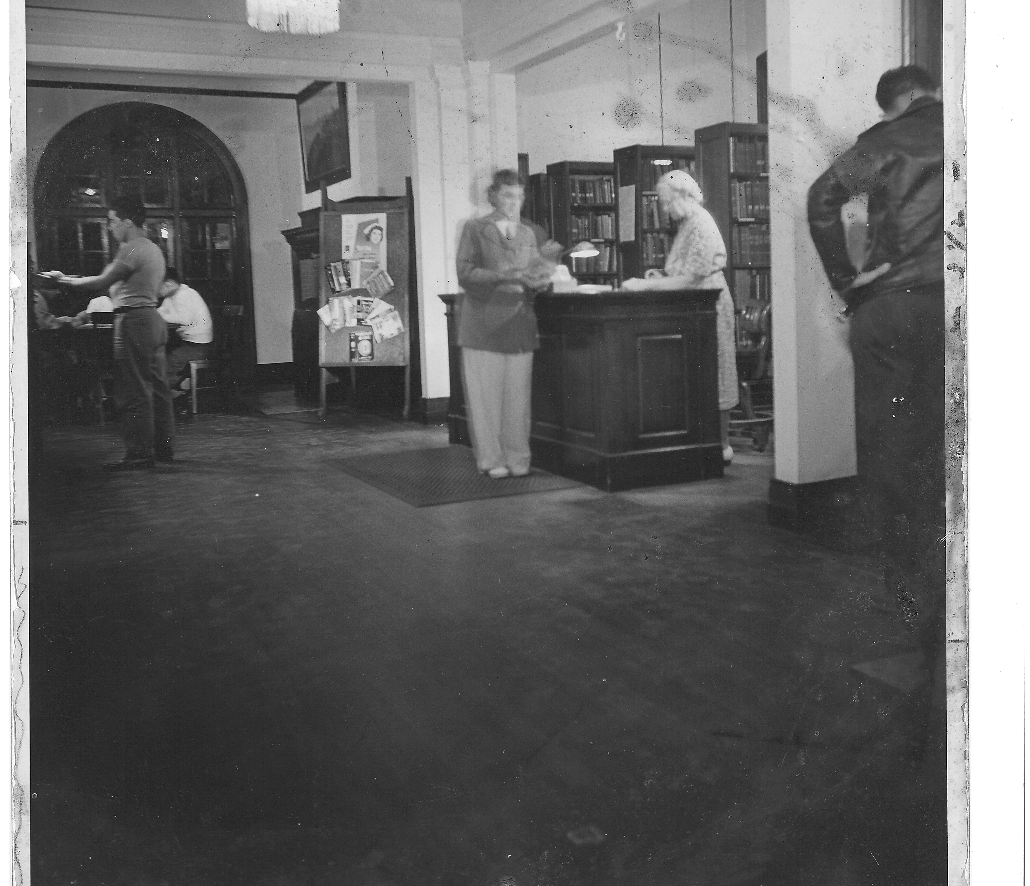
Cragin Memorial Library Interior, c 1940’s
In 2002 the Cragin Memorial library was expanded from its original 4,000 square feet to its current size of 20,000 square feet. From 1905 until 2002 the Library was governed by the Cragin Memorial Library Board of Trustees. Since 2002 the library has been a department of the town of Colchester with the library board of trustees acting in an advisory and support role.

Slide 11

Questions or Comments

Slide 12
Colchester Book Cover
Arcadia Publishing’s Images of America book series “Colchester” book written by me on behalf of the Colchester Historical Society was published on January 11, 2021. It is available through Amazon, Barnes and Noble and other book outlets as well as at a discounted price at the Colchester History Museum. Please note that all royalties from the sale of the book go to the historical society.

