Slide 1
“The Catskills of Connecticut”- The Jewish
Hotel and Resort Business in Colchester
Gary A. Walter
Colchester Historical Society
March 2021

Slide 2
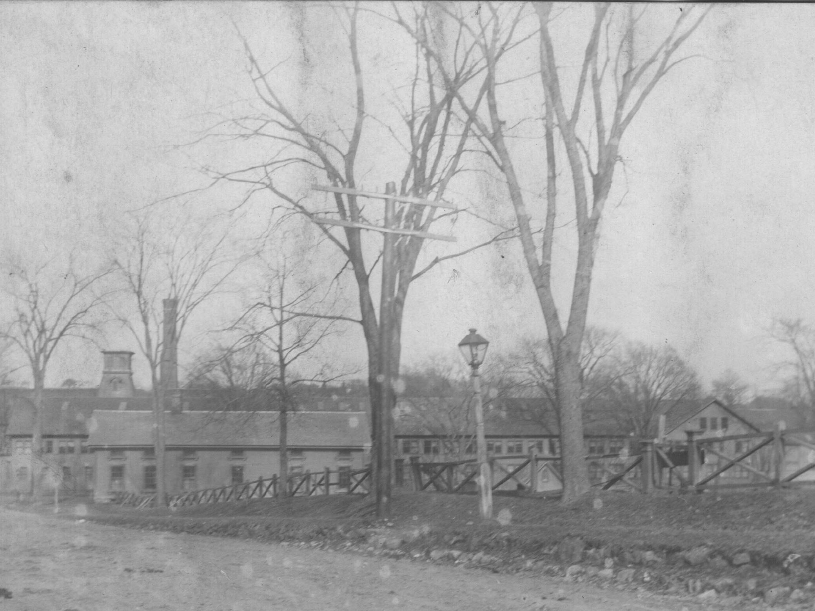
View of Hayward Rubber Company Complex from Lebanon Avenue
Colchester has experienced several cycles of boom and bust. The biggest boom was probably when the Hayward Rubber Company factory opened in 1848. The factory typically employed between 600 and 1000 people who along with the factory itself provided a reliable customer base for local farms and businesses.

Slide 3
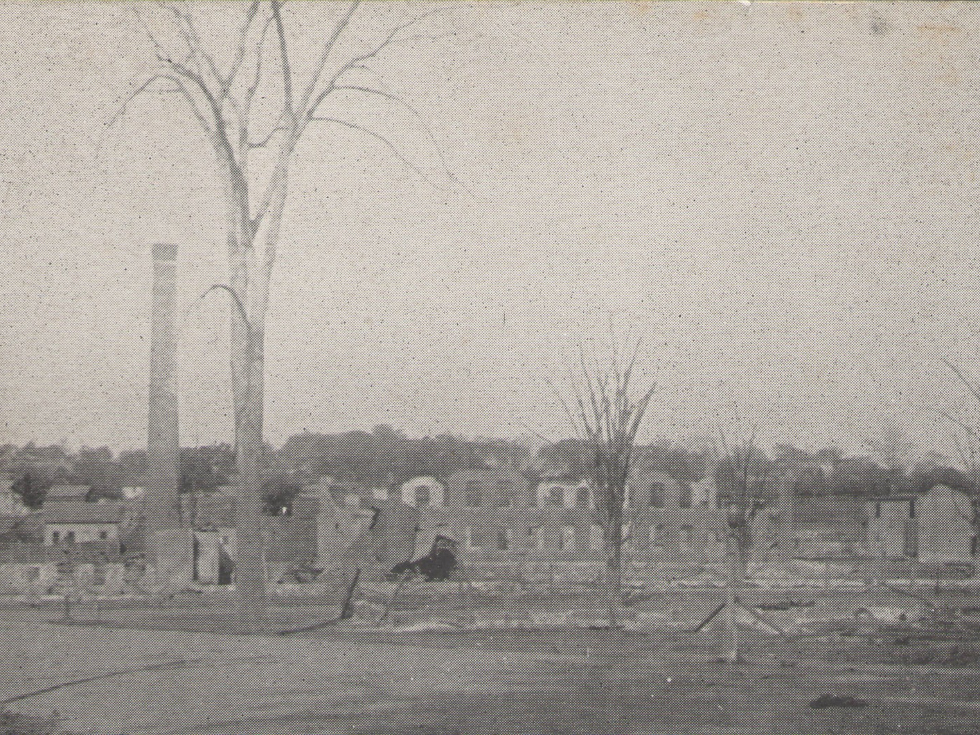
View of Colchester Rubber Company Ruins after 1908 Fire
There is no doubt that the biggest bust in Colchester’s history was the unannounced closing of the by then renamed Colchester Rubber Company factory at the end of 1893. The abandoned buildings later burned down in a massive fire in 1908.

Slide 4
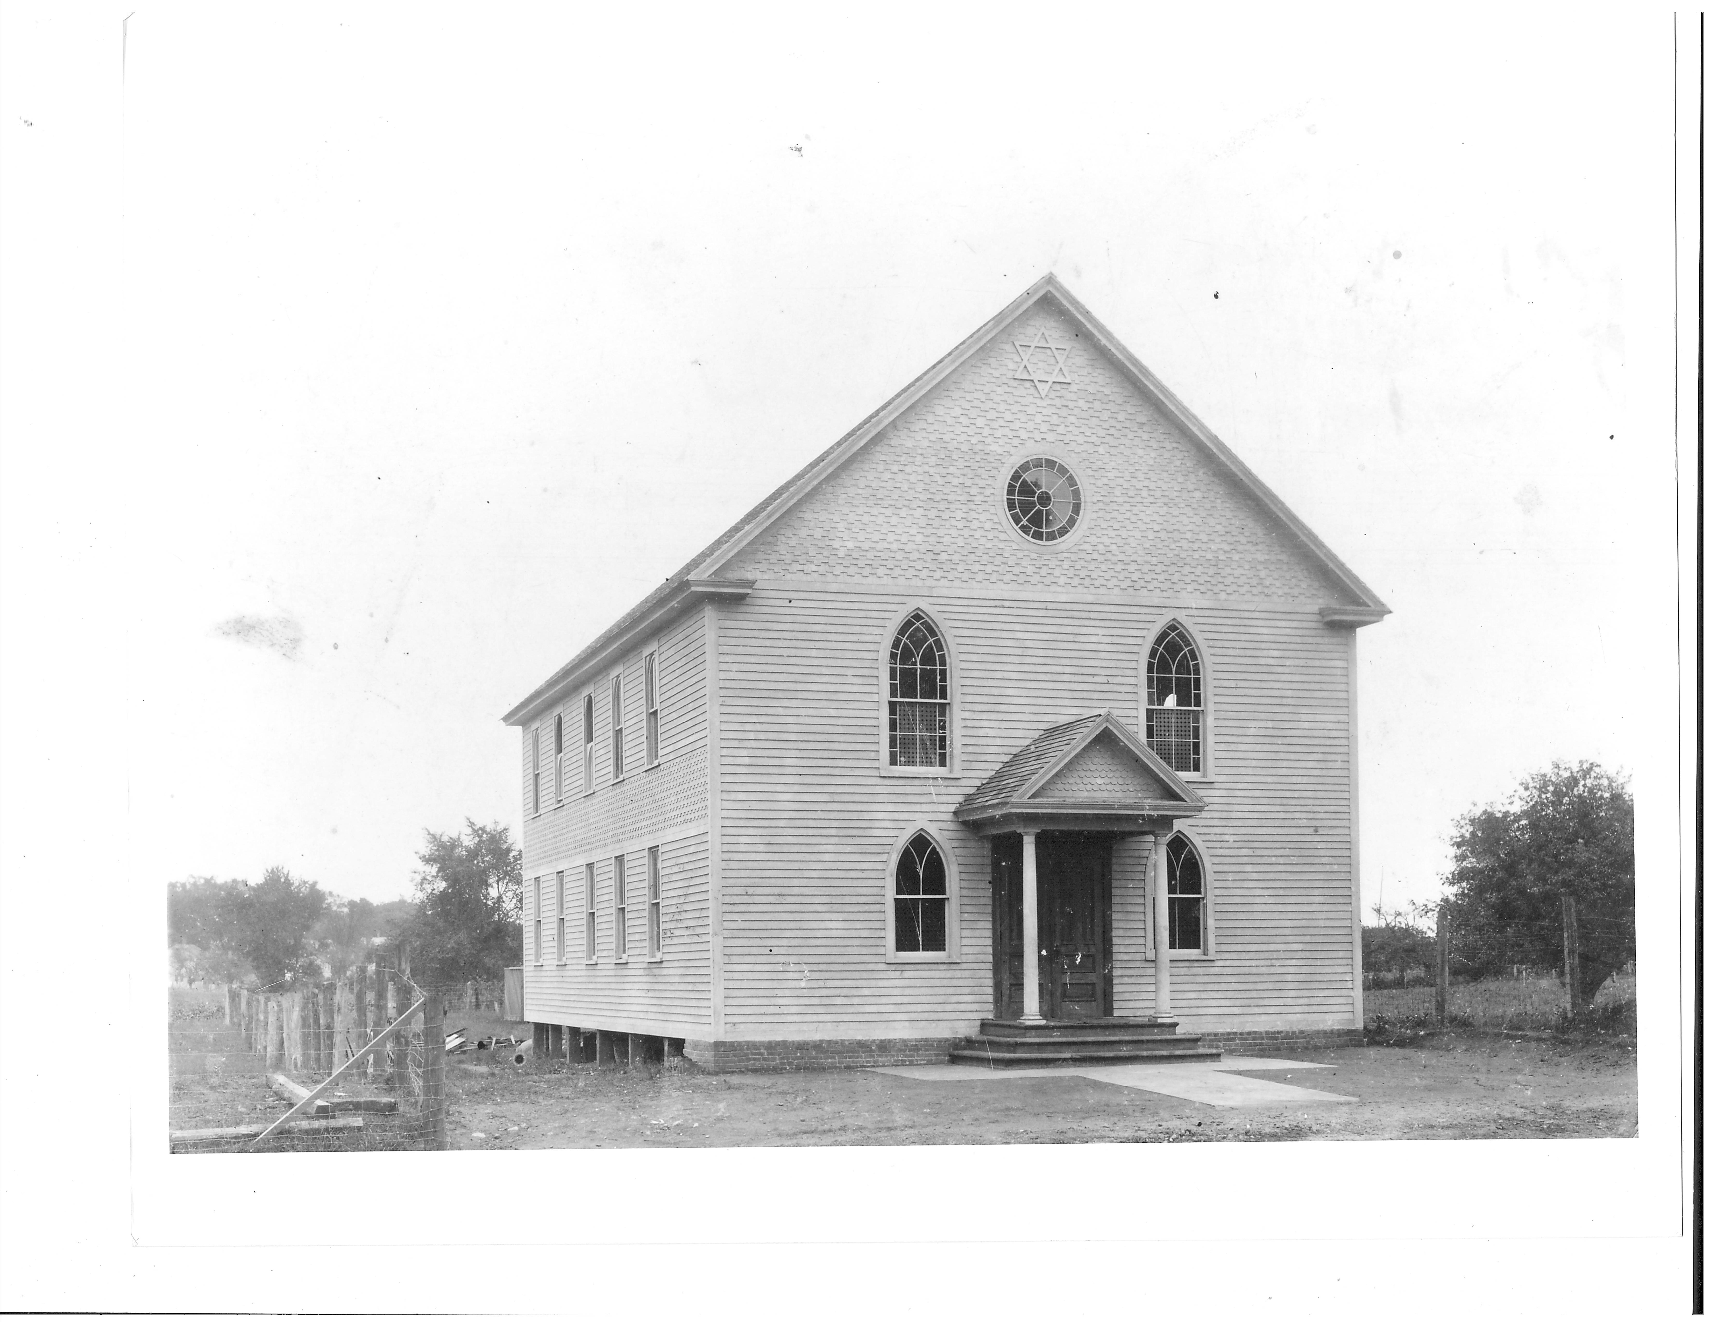
Ahavath Achim Synagogue on Lebanon Avenue , built in 1913
There were a few Jewish people living in Colchester before the closing of the rubber factory however, after it closed the Jewish population grew considerably over the following decades. This was due in part because for a long time after the factory closed there was lots of inexpensive real estate for sale. These Jewish settlers established a variety of successful farms and businesses that helped Colchester’s economy to gradually recover. By 1930 fully a third of Colchester’s population was Jewish. The building shown was torn down in the 1960’s when the current Synagogue was built.

Slide 5
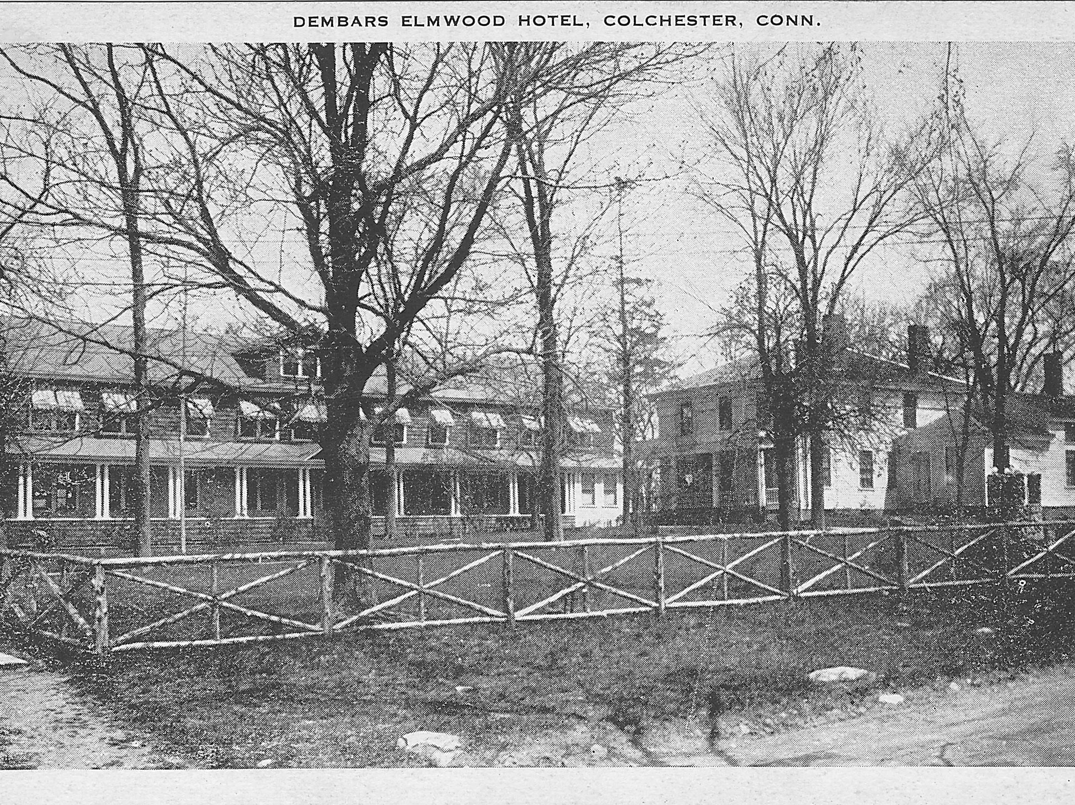
The Dember Elmwood Hotel on Halls Hill Road
One of the businesses that the Jewish newcomers to Colchester established was summer resorts. In 1911 one of these people was Barnett Dember who built the Dember Elmwood House shown in the photograph. This resort catered to a mostly Jewish clientele and operated until the Great Depression did it in around 1933. The resort business in Colchester was greatly helped by the fact that there was passenger train service to Colchester into the 1930’s. The main building in the photograph is still there.

Slide 6
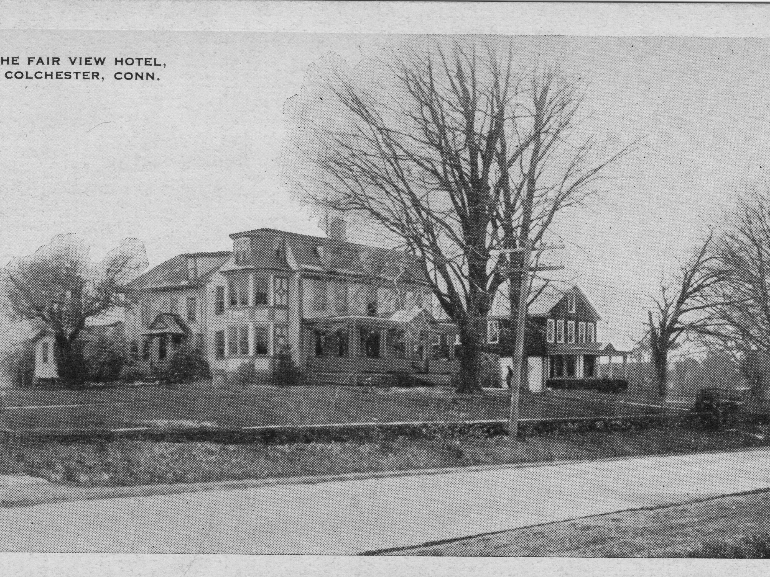
The Fairview Hotel and Annex on the West Side of Broadway
The Fairview Hotel on the left of the photograph was built in the early 19th century as a private house. It later became a boarding house for single female workers of the rubber company. In 1919 Harris Cohen transformed it into a hotel and resort catering mostly to Jewish people and was quite successful into the 1940’s. The building now houses professional office space. The hotel’s annex to the right in the photograph was built in the 1920’s, but no longer exists.

Slide 7
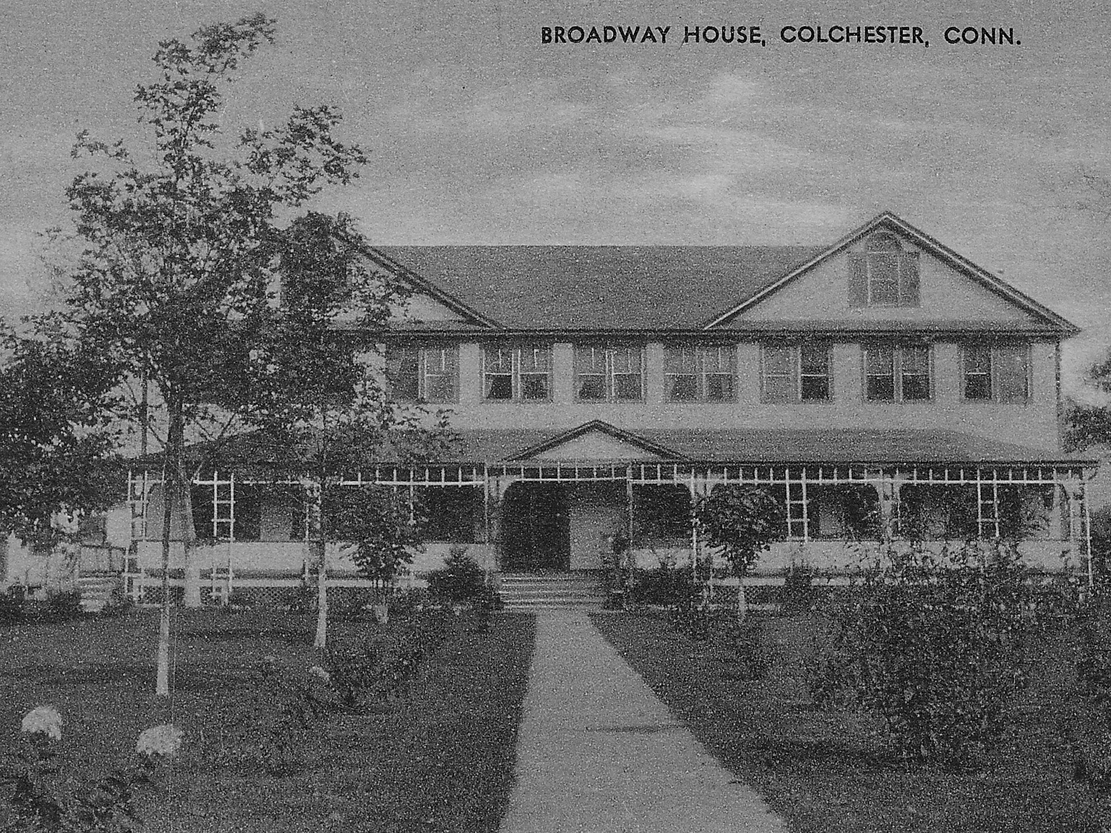
The Broadway House Hotel on the East Side of Broadway
Another highly successful hotel / resort was built and owned by Abraham and Rose Jaffe around 1920 and was located back from Broadway on what is now Jaffe Terrace across the street from the Fairview Hotel. This building no longer exists. The Broadway House also had an annex building (not shown) closer to Broadway that does still exists as an apartment building at 116 Broadway.

Slide 8
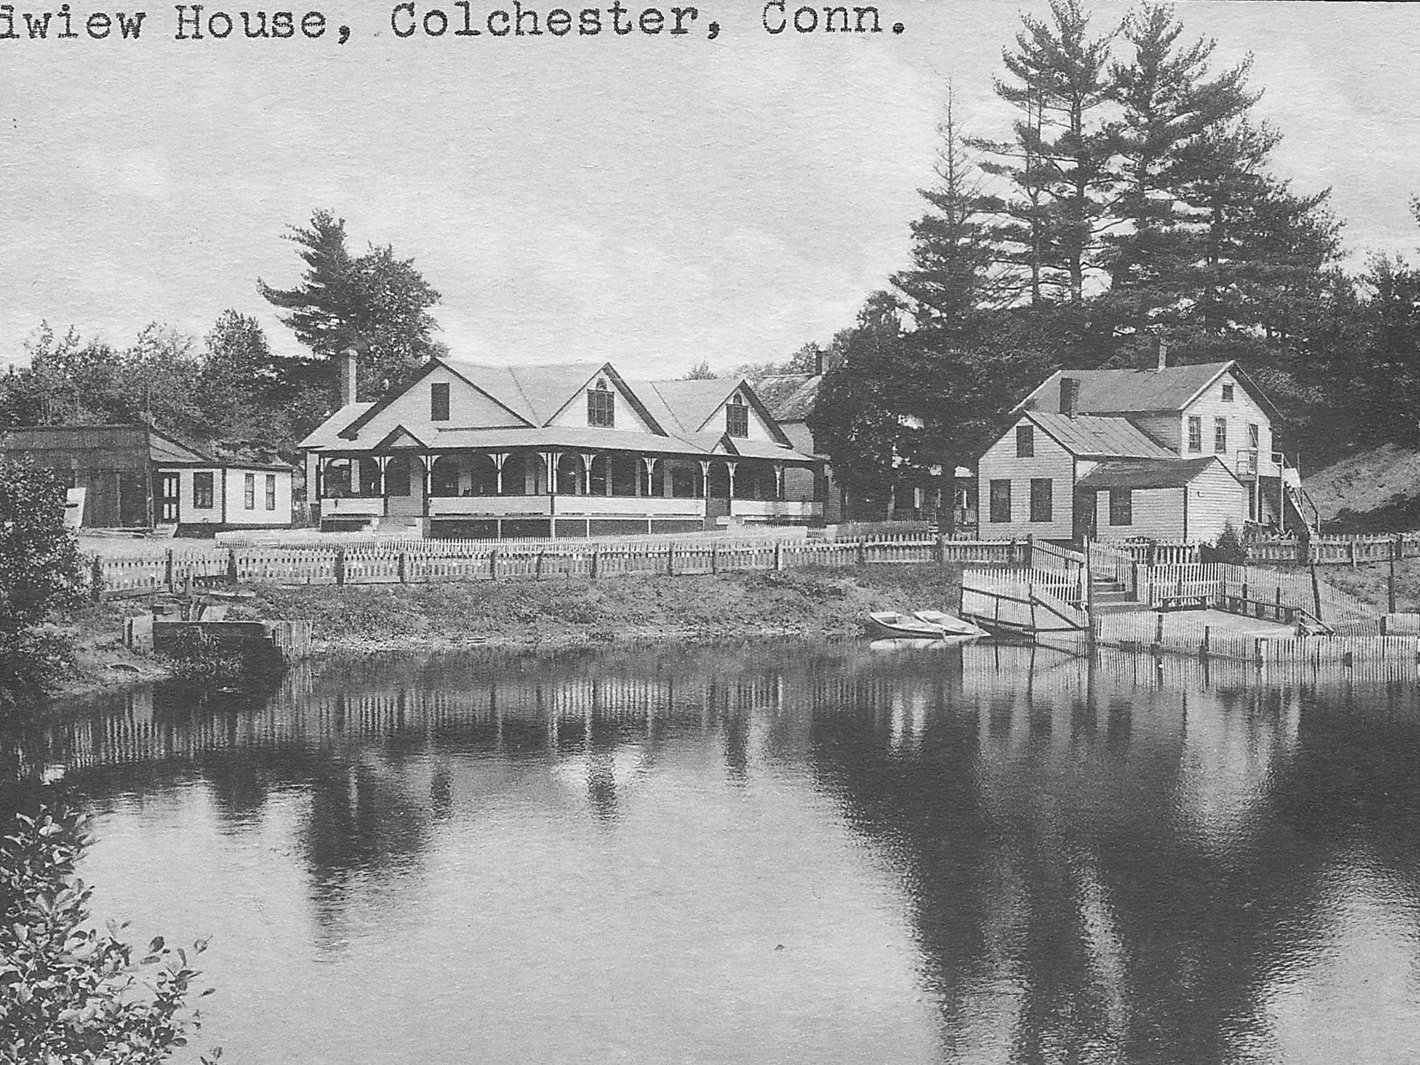
Levi’s Grand View Resort off of Linwood Cemetery Road
In 1922 Charles Levi bought a small resort that had been built by the Elgart family next to their large mill pond fed by the Meadow Brook and located behind Linwood Cemetery. Levi greatly expanded this resort and it became the largest one in Colchester and was very successfully into the 1960’s when it changed owners and became the Lincoln Lake Lodge, which is now closed. When this and the other resorts were in their heyday Colchester’s summer population would often double.

Slide 9
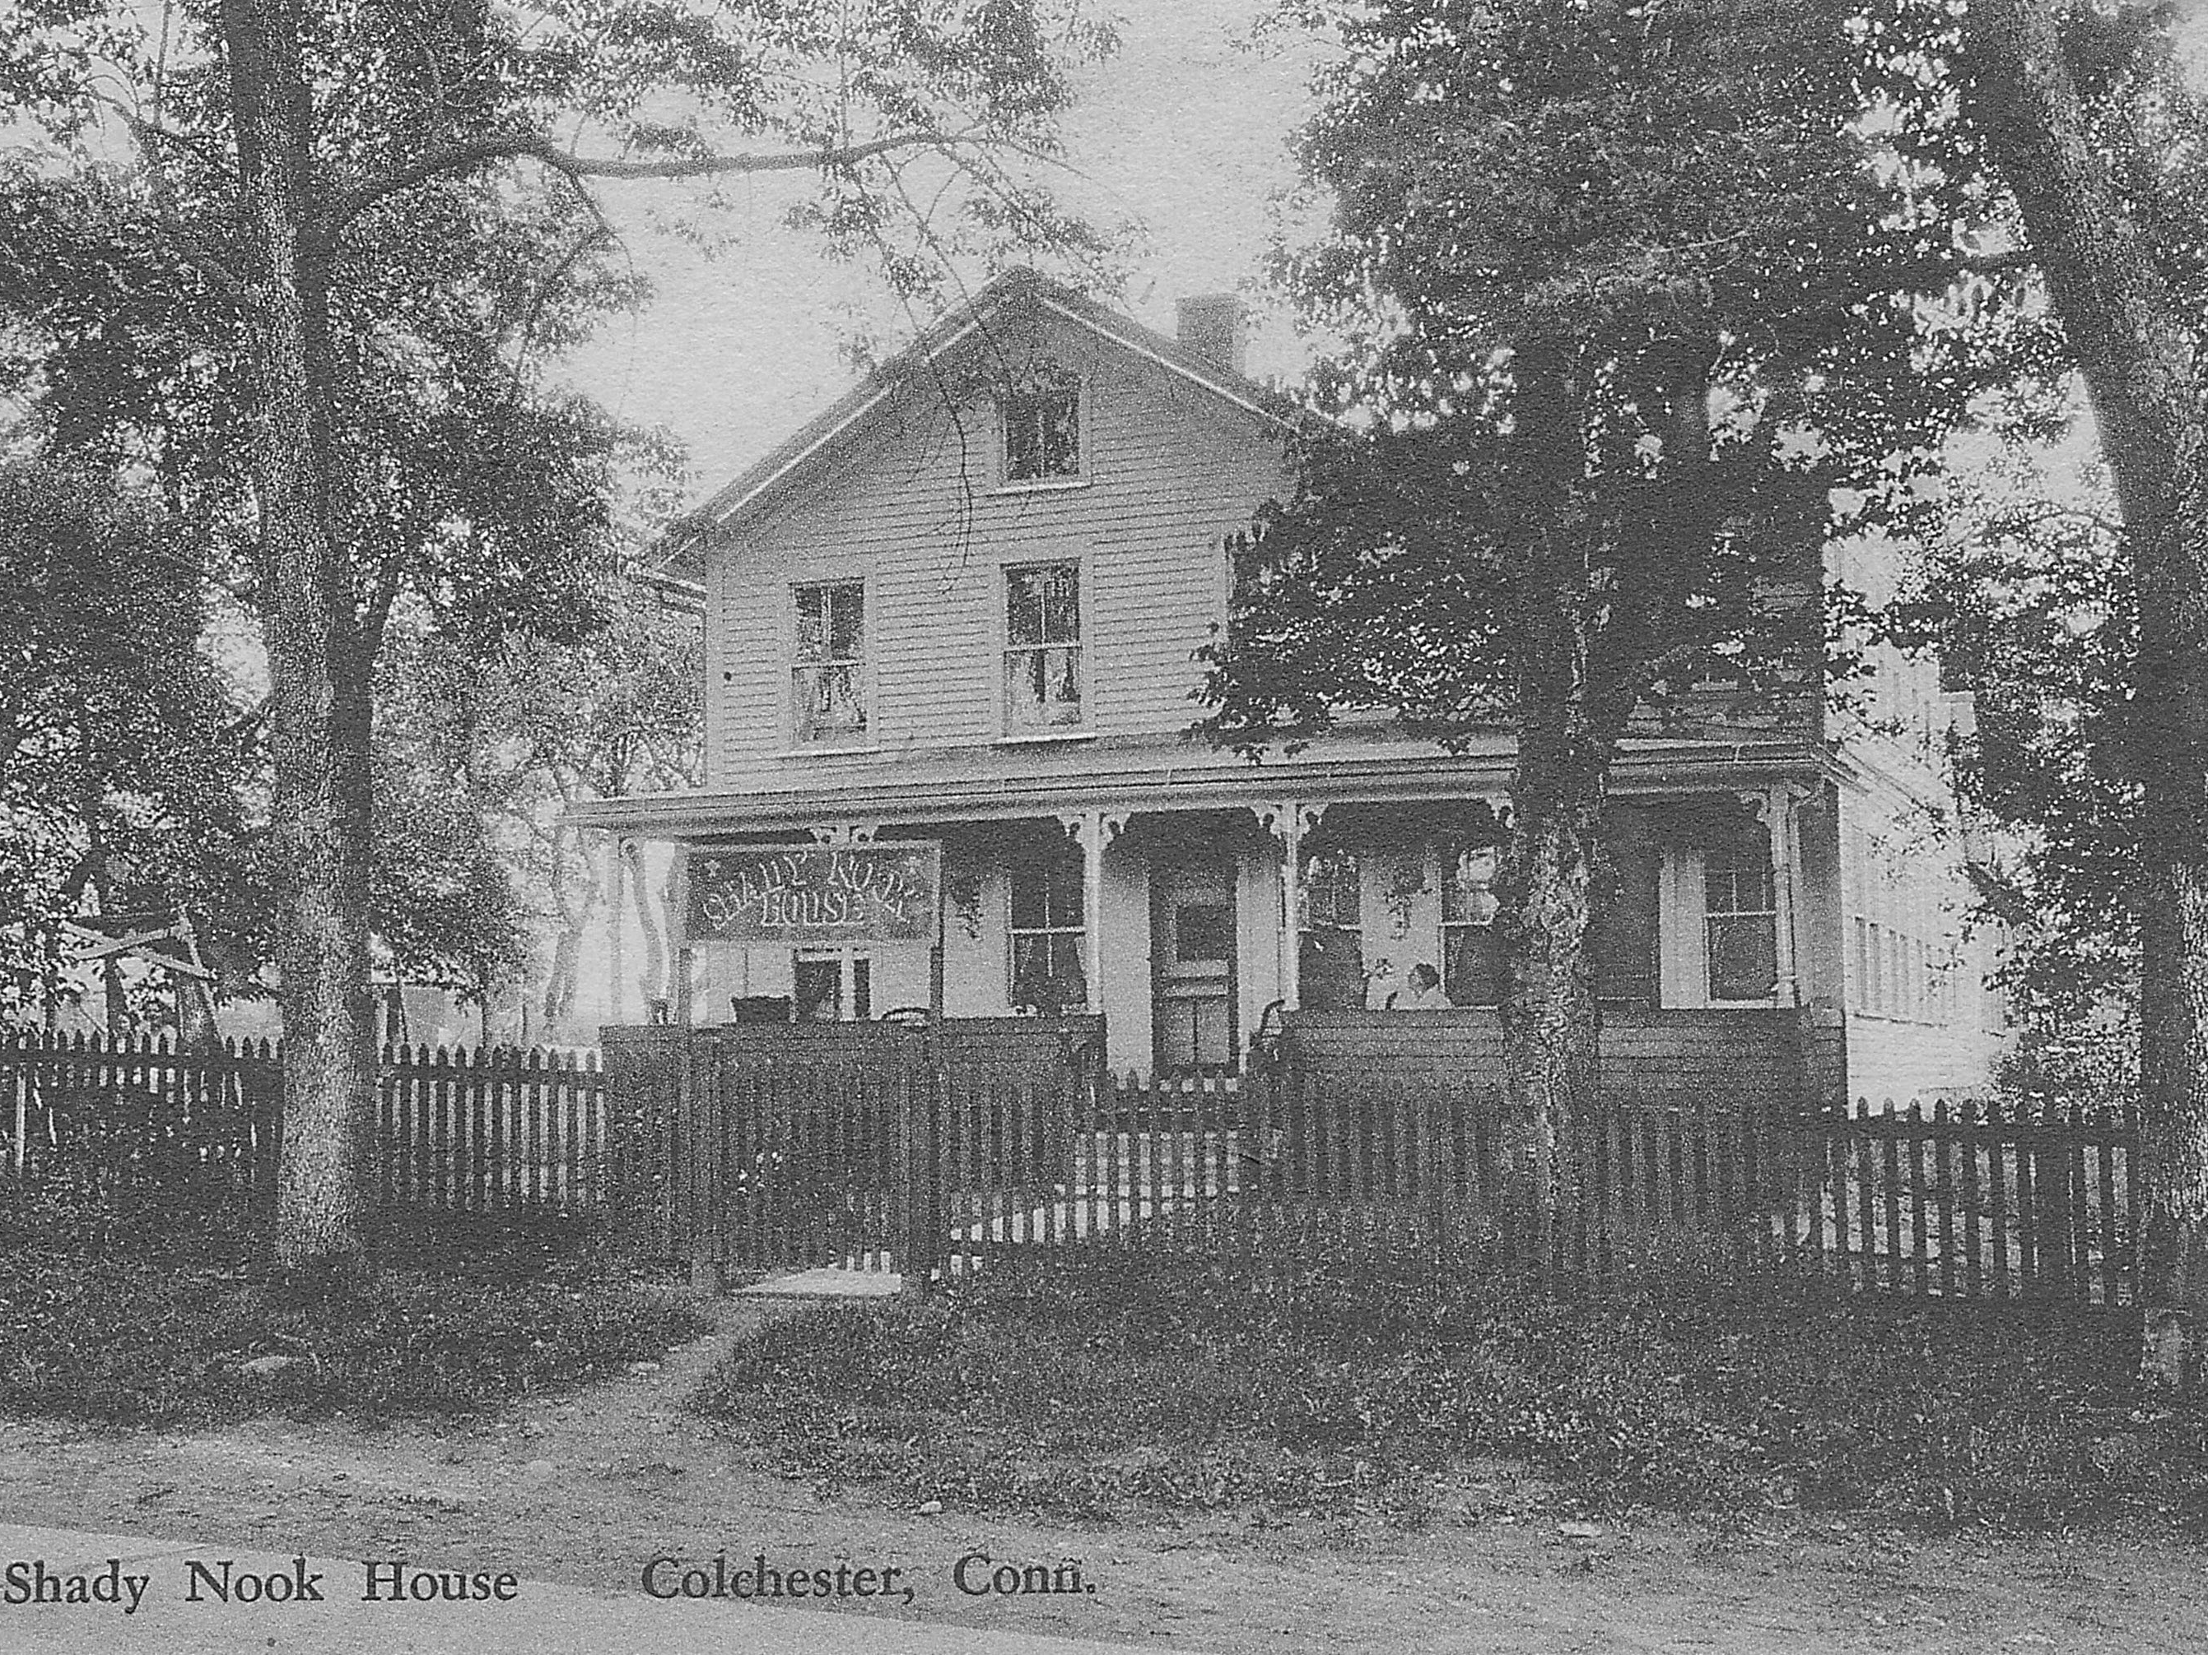
The Shady Nook House at 272 Norwich Avenue
“The Shady Nook House” was an in-town summer resort owned and operated by Max and Moline Cohen. One of Max and Moline’s five children was Rubin “Ruby” Cohen who is locally famous for owning “Harry’s Place” dinner from the 1930’s to the 1970’s and also for served as Colchester’s Representative in the Connecticut General Assembly for 30 years starting in the 1940’s.

Slide 10
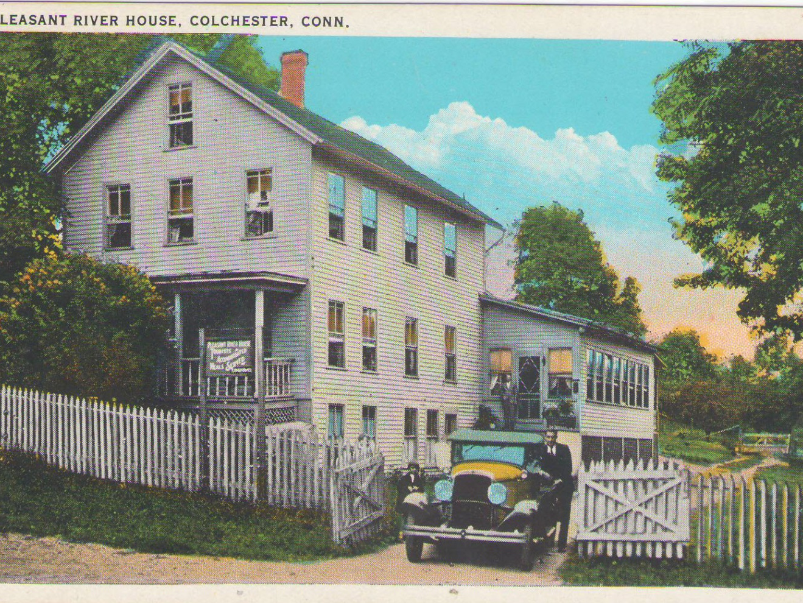
Pleasant River House on Norwich Avenue
This photograph shows another example of a Hotel / Resort from Colchester’s “Catskills of Connecticut” era in the first half of the 20th century. There are yet other such examples that I don’t have the time or space to show, such as, Grief’s Hotel also on Norwich Avenue and Sultan’s Hilltop House on Windham Avenue. I would be remiss if I didn’t mention that Moodus also had a large Jewish resort business and is considered part of the “Catskills of Connecticut” area.

Slide 11
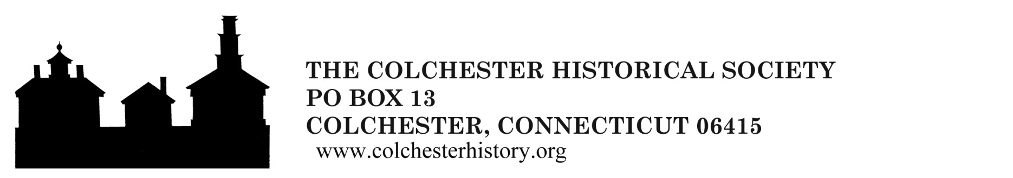
Questions or Comments

Slide 12
Colchester Book Cover
Arcadia Publishing’s Images of America book series “Colchester” book written by me on behalf of the Colchester Historical Society was published on January 11, 2021. It is available through Amazon, Barnes and Noble and other book outlets as well as at the Colchester History Museum. Please note that all royalties from the sale of the book go to the historical society.

